Slide 1
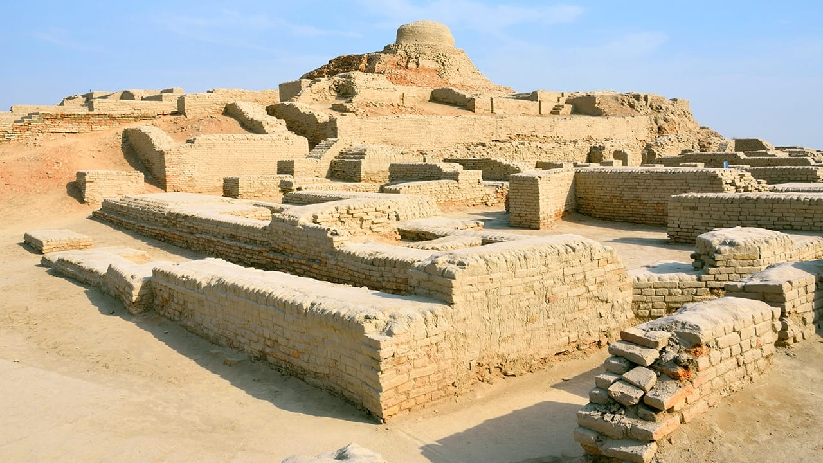
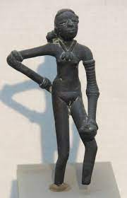
Indus Valley Girls
Deciphering Indus Valley Harappan Script
Keerthana Jayakumar
Sonia Sharma

Slide 2
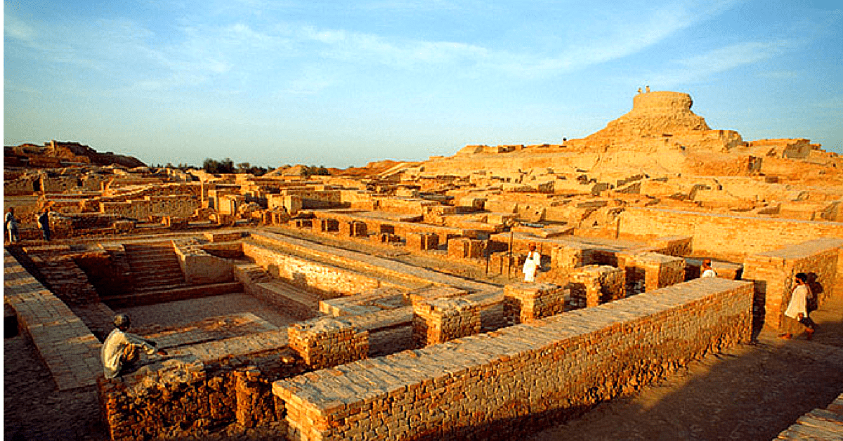
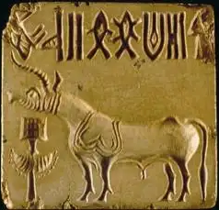
Purpose
This project is an attempt to decipher ancient Indus Valley script by comparing it to modern Tamil (a Dravidian language)
Our strategy is to:
Convert Tamil script from syllabic to logosyllabic by converting morphemes to signs. Perform statistical analysis to compare the converted script with the Indus script.
Testing the hypothesis that Proto Dravidian is the language of the Harappans by comparing modern Tamil with the Harappan script.

Slide 3
Plan
Use Python's pandas library on the tagged database to convert Tamil script from syllabic to logosyllabic. Tagged dataset used: https://ufal.mff.cuni.cz/~ramasamy/tamiltb/0.1/introduction.html#1.2.Data
The first tagged Tamil database has segmented some of the morphemes but not all of them. We completed segmenting the noun and verb morphemes using Python and then assigned new signs to them.
Use PostgreSQL on an AWS RDS instance to store cleaned data. We have selected a cloud server so both members of our team can access the data.
Train an SVM machine learning algorithm (from SciKitLearn library) on the morpheme segmented dataset and run it on an old Tamil dataset.

Slide 4
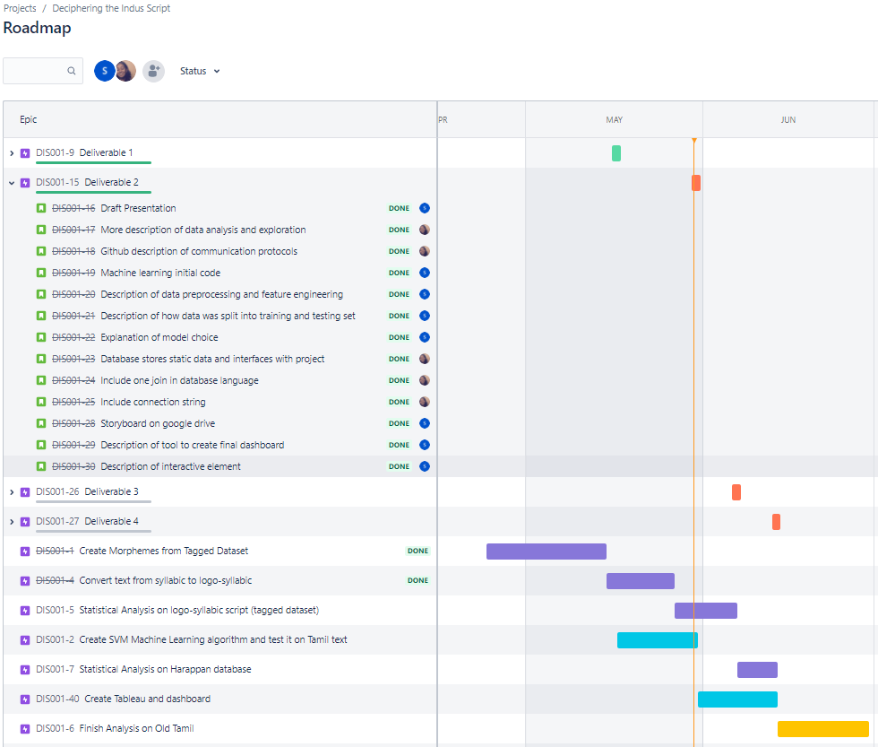
Activity Roadmap

Slide 5
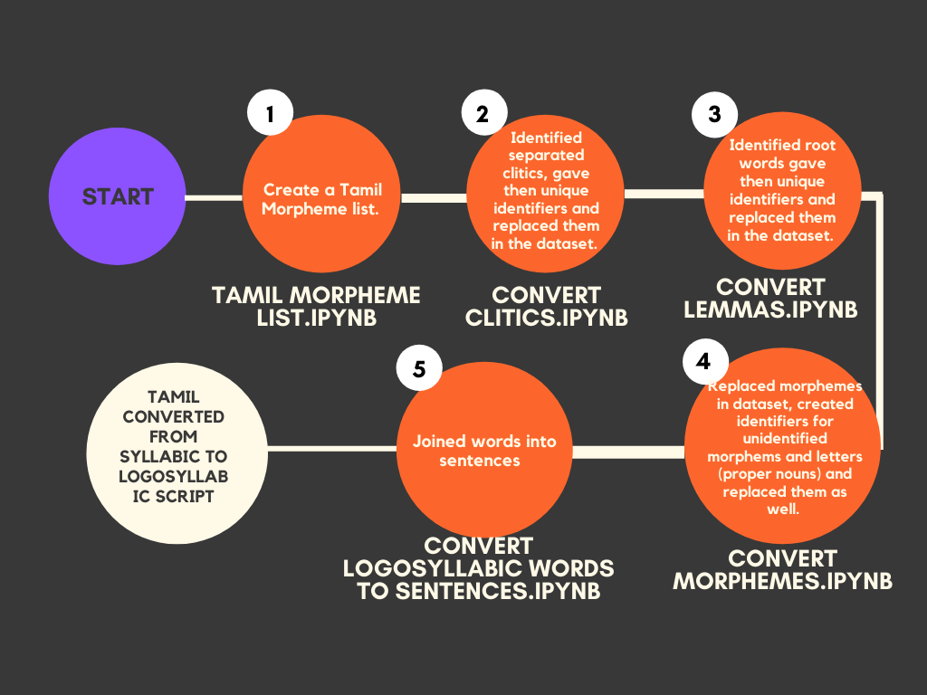
DATA PREPROCESSING STEPS

Slide 6
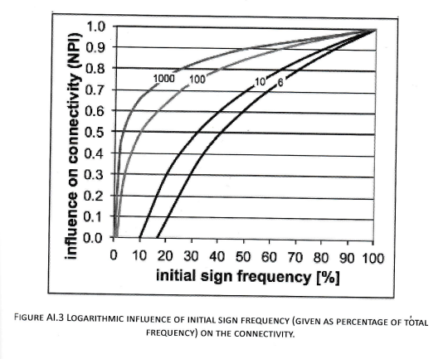
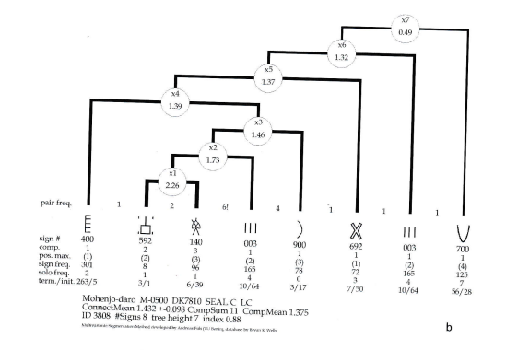
Analysis
We will perform statistical analysis in R on both the Tamil and Indus scripts to evaluate metrics such as sign connectivity, positional frequency and polyvalency. Some methods we will use include z-scores, multivariate segmentation method and frequency histograms.

Slide 7
Machine Learning
We created a SVM algorithm with the purpose of automatically performing morpheme extraction on Tamil
We preprocessed the data and selected our features: index, vowel/consonant, noun, verb, current letter encoded, current prefix encoded. The output label for our model was the morpheme boundary.
After experimenting, we opted to utilize the default 75% training and 25% testing data split and selected a rbf kernel with a gamma of 0.8 to achieve an accuracy of 76%.

Slide 8
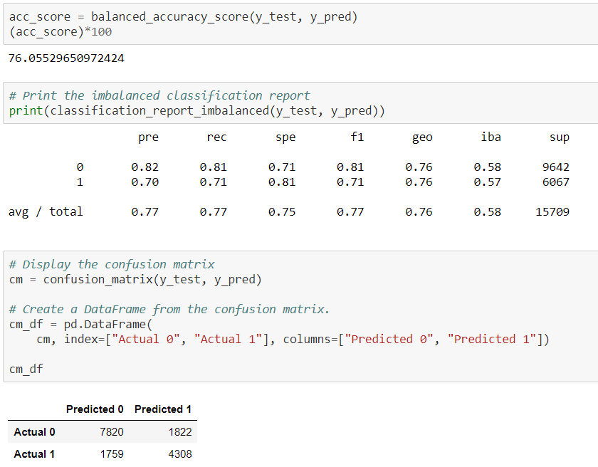
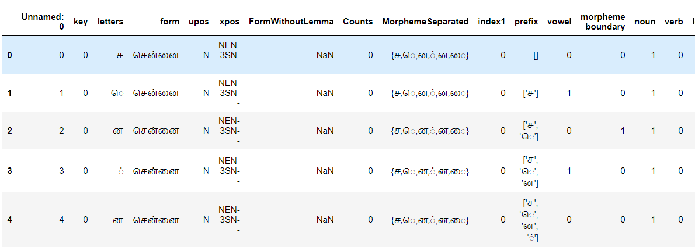
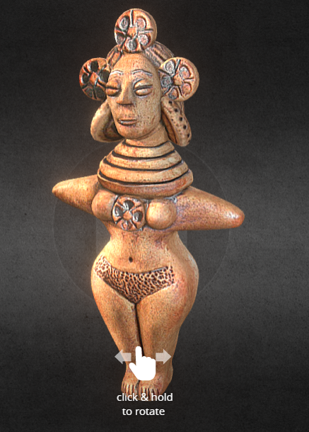
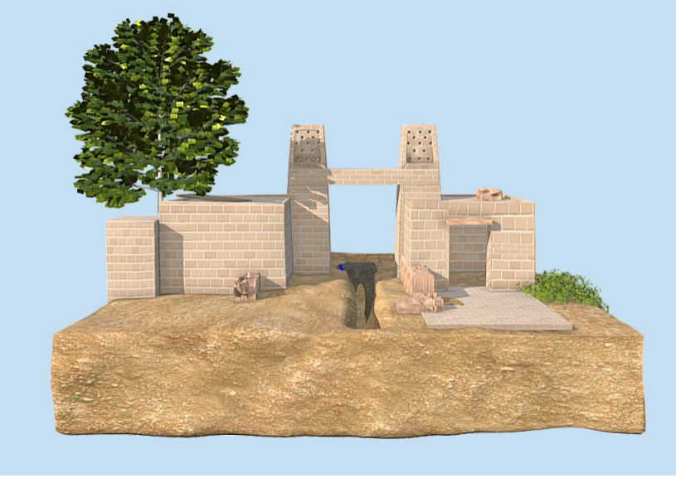
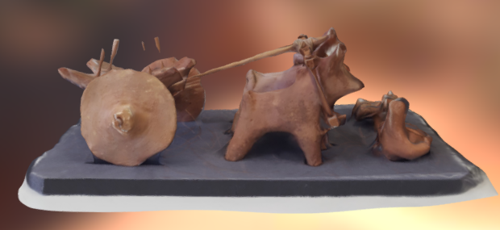
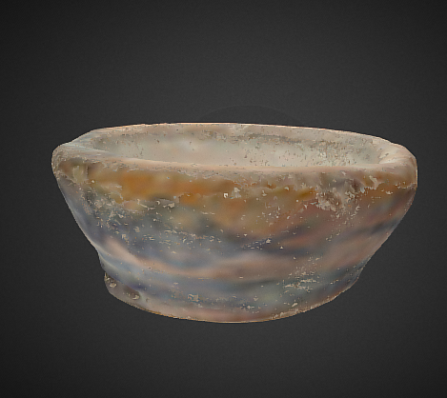
Visualization
Plan to show:
SQL dataframes containing segmented morphemes and corresponding signs
Machine Learning SVM accuracy results
Statistical Analysis of Tamil and Indus scripts (graphs such as frequency histograms as seen on Analysis slide)
3D models of Indus Valley Harrapan artifacts and civilization using Three.js and Sketchfab. Plan to host on Heroku
Users will be able to click on each section to view SVM results, dataframes, statistical analysis results as well as interact with 3D artifacts to view historical facts about Indus Valley Civilization

